Slide 1
Hybrid Model for Stock Price Correlation Coefficient Prediction
Using SARIMAX-LSTM Hybrid model.

Slide 2
Agenda
Introduction
Motivation
Architecture
Conceptual Design
Results

Slide 3
Introduction
Understanding stocks and market cap of firms. Market cap is a direct indicator of firm’s financial well being
Common Indicators to measure condition of the stock market. (S&P 500, Dow Jones, NASDAQ).
Assumptions on the stock market.
Randomness of the market.
History repeats itself.
Rationality.
Perfectness

Slide 4
Introduction
Modern Portfolio Theory and Historical Models for Coefficient Prediction.
Statistical and Neural Network Models for Coefficient Prediction.
Laying groundwork for hybrid models.
Prior work done in the field of hybrid models.
Peter Zhang’s model
Ray Nelson and James Hansen model
Hyeong Kyu Choi’s model

Slide 5
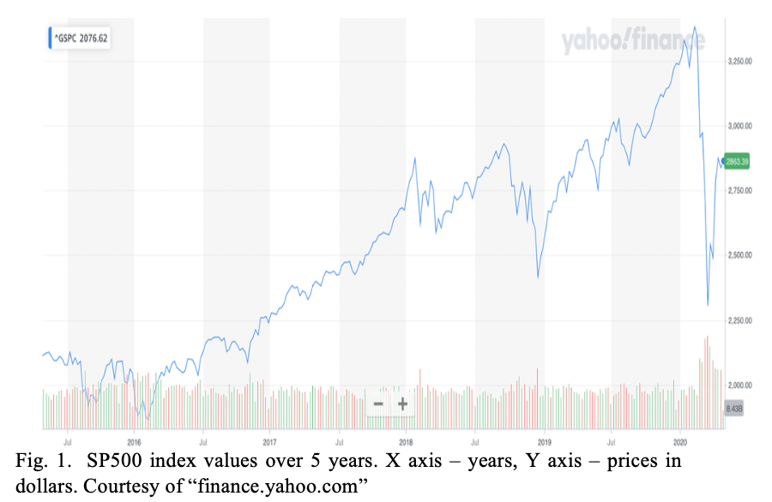
Motivation
Issue with the ARIMA-LSTM model – Seasonality of Stock Correlation Coefficient data.
SARIMAX – a new twist on the old tale of hybrid models.

Slide 6
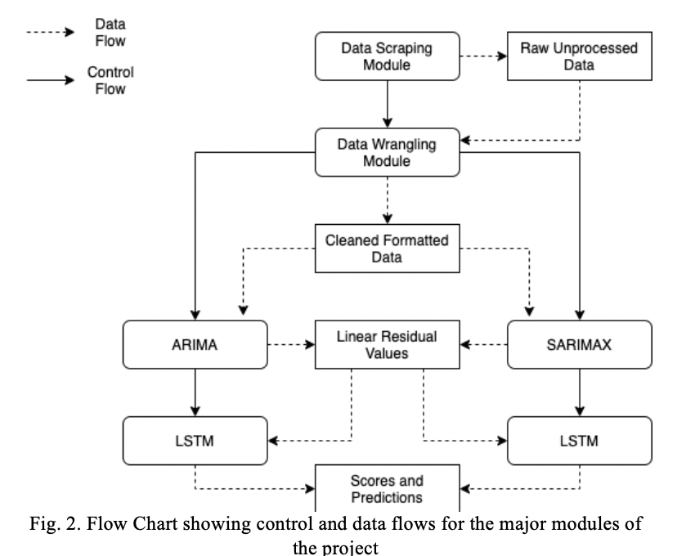
Architecture

Slide 7
Conceptual Design
Data Scraping
Scraping S&P500 firms ticker list from Wikipedia – Beautiful Soup Library
Scraping individual stock data using the previously extracted tickers – Alpha Vantage API
Keys required for access.
Restriction of per min API access. Workaround of explicit wait and multiple keys.
Data Wrangling
Extract Transform Load – The process of obtaining clean data.
Data Imputation and Data Deletion – Identifying ineligible stocks and fixing Adjusted Close prices of the stocks.

Slide 8
Conceptual Design
Auto Regressive Integrated Moving Averages – ARIMA
Coefficient Calculation using rolling window. Train/Dev/Test set generation.
Parameters of ARIMA model – AR, I and MA (p, d , q)
Akaike Information Criterion (AIC) – Parameter Optimization
Seasonal Auto Regressive Integrated Moving Averages using Explanatory Variables – SARIMAX
Coefficient Calculation using rolling window. Train/Dev/Test set generation.
Parameters of ARIMA model – AR, I and MA (p, d , q). Additional parameters (P, D, Q) m
Akaike Information Criterion (AIC) – Parameter Optimization

Slide 9
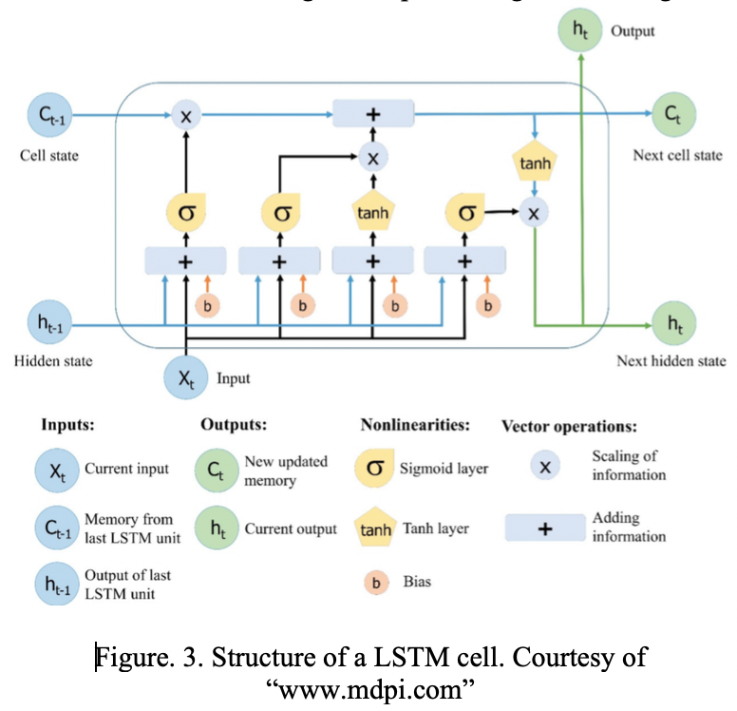
Conceptual Design
Structure of a LSTM cell.

Slide 10
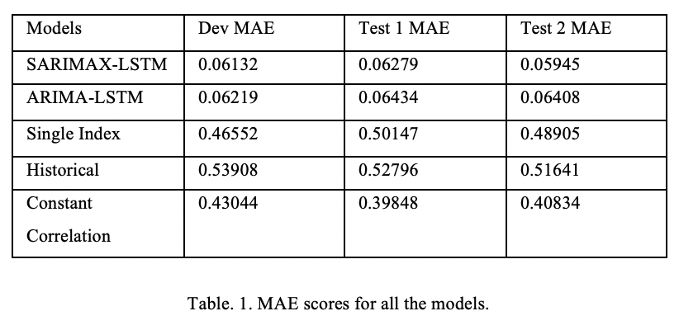
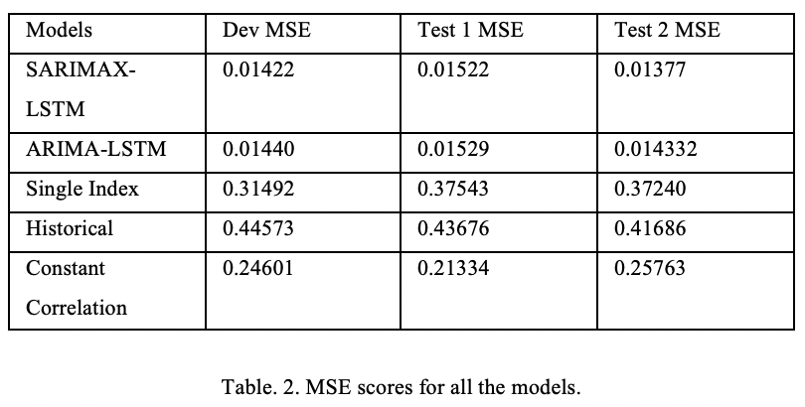
Results
ARIMA-LSTM vs SARIMAX LSTM.
SARIMAX-LSTM vs Historical models.
SARIMAX-LSTM clear winner.

